Slide 1
Wireshark Firewall Analysis
By: Chase McLaughlin

Slide 2
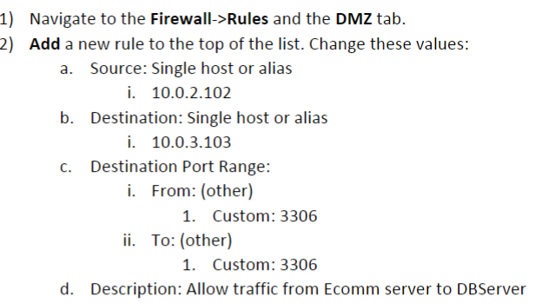
DMZ Segment MYSQL Allow Rule
Rules added to the DMZ segment
Allow Ecomm MYSQL(Port 3306), DNS requests, network segment traffic rejection

Slide 3
Wireshark Project Lab Instructions
Wireshark installed with the Linux command sudo apt install Wireshark.
The Wireshark installation was completed on the Ecommerce DB VM.
We began by running a tcpdump of the network and saving it to the allow_deny.pcap file
We began the tcpdump by having the MYSQL Allow rule toggle ON. We Loaded the web page and generated successful 3WHs.
We then toggled the MYSQL Allow rule OFF. From this, we reloaded the web page and generated failed 3WHs.
We then opened the pcap file in Wireshark and performed the analysis in slides 8-9.

Slide 4
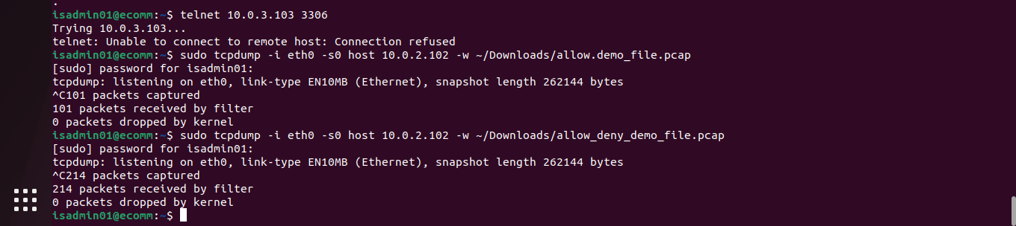
Linux Command used to run tcpdump
Tcpdump Breakdown:
Tcpdump & Wireshark utilized on the Ecomm server network segment
Using the ethernet interface
Isolating host 10.0.2.102
File saved to downloads folder as allow_deny_demo_file.pcap

Slide 5
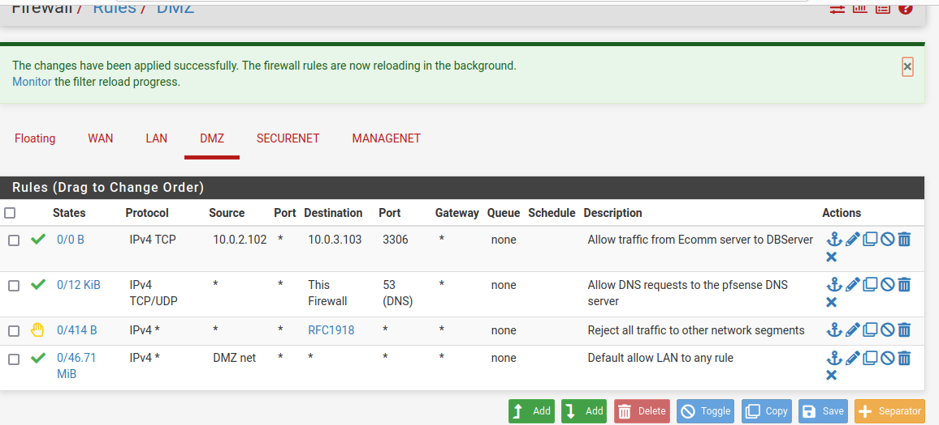
Pfsense MYSQL Allow Rule Toggled ON

Slide 6
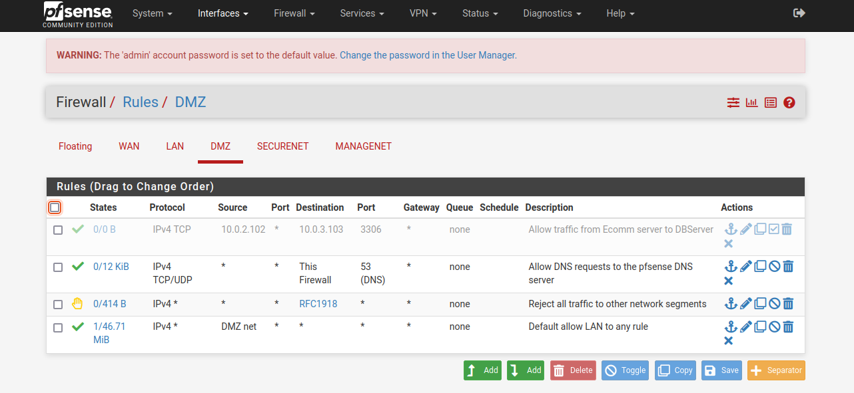
Pfsense MYSQL Allow Rule Toggled OFF

Slide 7
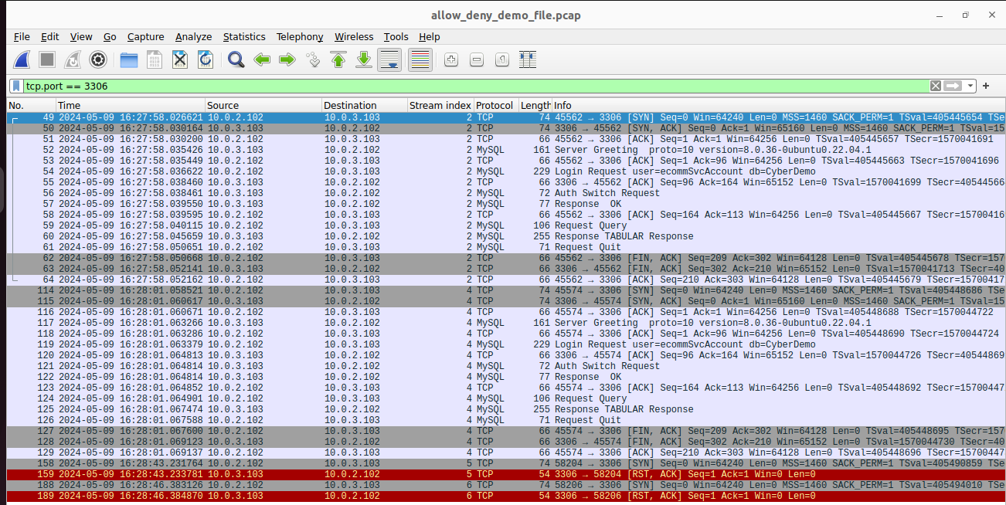
Initial Wireshark Packet Capture

Slide 8
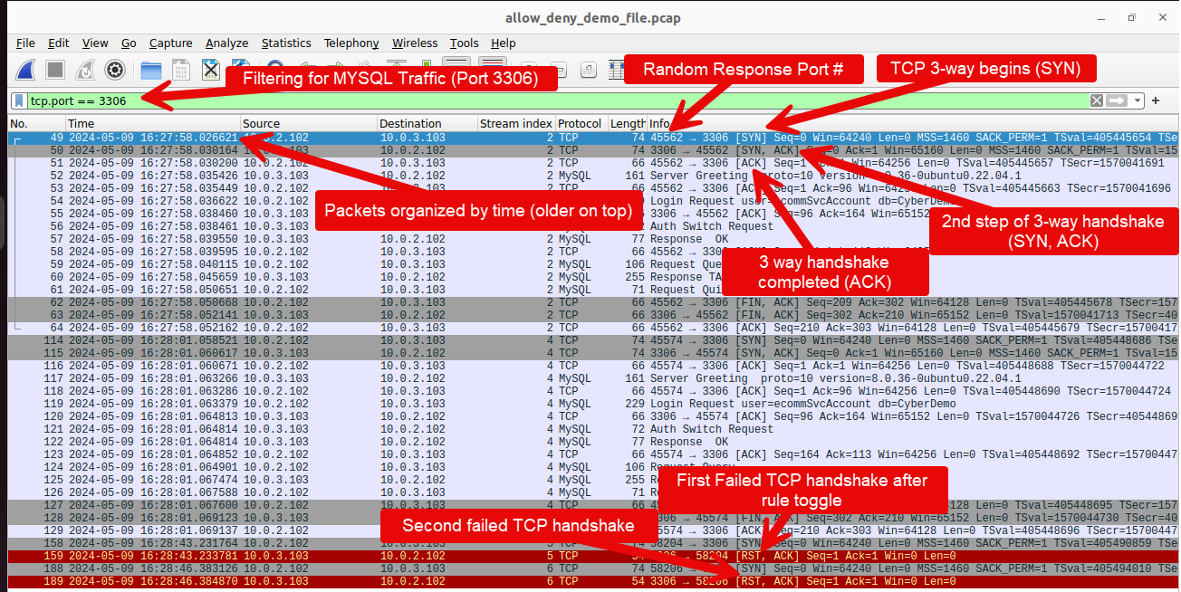
Annotated Wireshark Packet Capture

Slide 9
Wireshark Packet Capture Description
Stream Indices 2-4 illustrate proper 3-way TCP handshakes.
While the Allow MYSQL traffic rule is toggled on the webpage works as intended.
Stream indices 5-6 showcase failed instances of the 3-way handshake.
During this the webpage is not accessible to the client.

Slide 10
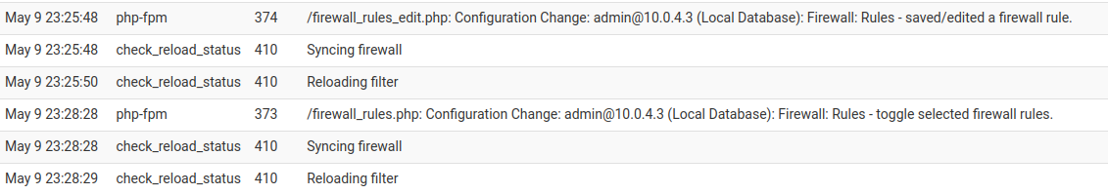
Pfsense Firewall Rule Log
Pfsense Firewall Rule log timing matches the new failed communication stream from the Wireshark packet capture.

Slide 11
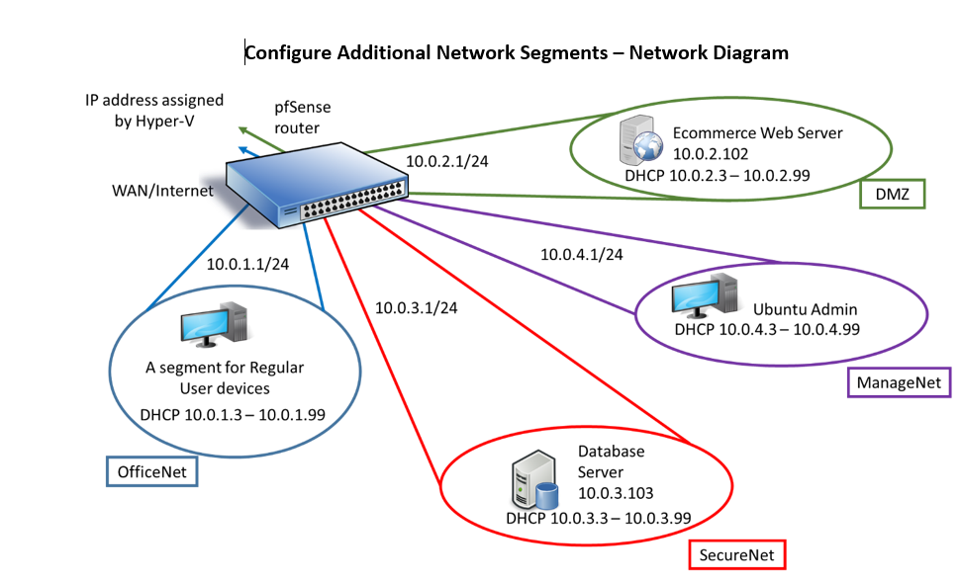
Lab Network Diagram Review
The Firewall rule sits between the E-commerce Web server (DMZ) on 10.0.2.102 and the MYSQL Database server on 10.0.3.103.
Within this lab we utilized tcpdump and Wireshark on the Ecommerce web server.
The firewall rule allows segment communication
When it is toggled off the network segments cannot communicate with one another.

Slide 12
Conclusion

